Slide 1

Optimizing Cosmetic Formulations Using Product Reformulation Trends
Olivia Folly-Gah

Slide 2
Objective
Identify trends in cosmetic product reformulations due to hazardous ingredients.
Address dataset challenges (categorical dominance and imbalance) to improve analysis.
Provide actionable insights for safer, science-backed cosmetic formulations.
Notes:
My main objective is to Analyze reformulation trends in cosmetic products and identify hazardous ingredients.
New Sub-Objective: Improve dataset quality by increasing numerical features for better analysis and model performance.
Give actual objective on top of the project one, so say wanna do random forest, what is it and what you plan on doing it, maybe focus on unbalanced data and how youre gonna handle that

Slide 3
Project Understanding
Key Discovery
Methodology
Dataset Overview
Based on California Safe Cosmetics Program (CSCP) data.
Contains 22 columns, including ProductName, ChemicalName, and Reformulation Dates.
Dataset aimed to report products containing chemicals linked to cancer, birth defects, or reproductive issues.
While the dataset flagged many chemicals as potentially harmful, only a small subset actually posed these risks.
Further highlights the need for better data labeling and contextual understanding of ingredients.
Feature Engineering: To quantify ingredient performance, I assigned numerical scores for efficacy, safety, and sustainability, allowing for direct comparisons.
Notes:
What I would like to do for the Methodology going forward:
Efficacy (Higher = Better):
Ingredients known for high performance (e.g., Retinol) received higher scores.
Less effective ingredients were assigned lower values.
Safety (Higher = Safer):
Not Hazardous chemicals got the highest safety score (10).
Confirmed Carcinogens received the lowest score (1), with other hazard types assigned based on severity.
Sustainability (Higher = Better):
Environmentally friendly ingredients scored higher (e.g., Mica = 9).
Less sustainable ingredients (e.g., Coal Tar Distillates) received lower scores.
Handling Imbalance: Addressed skewed data distribution between harmful and non-harmful chemicals.
Machine Learning Models: Built models to predict reformulation likelihood while focusing on interpretability.

Slide 4
Challenges
Solutions
Encoding
Categorical Overload
Applied one-hot encoding and target encoding for key categorical variables.
BrandName to reduce dimensionality.
Example: Replaced each brand with its average reformulation rate to capture trends.
Too many categorical columns (e.g., ProductName, ChemicalName) made modeling difficult.
Dataset Imbalance
Only a small portion of flagged chemicals caused cancer or other significant harm.
Cross-Reference
Noisy Data
Focused analysis on chemicals with stronger scientific evidence of harm.
Many flagged ingredients were not as harmful as initially reported.
Notes:
Applied Target Encoding for high-cardinality features like BrandName to reduce dimensionality.
Example: Replaced each brand with its average reformulation rate to capture trends.
Target Encoding for high-cardinality variables like BrandName, which had too many unique values for OHE.
Instead of creating hundreds of columns, I replaced each brand with its average reformulation rate, allowing the model to capture brand-specific trends efficiently.

Slide 5
Insights Discovered
Reformulation Trends: Most reformulations targeted parabens, phthalates, and formaldehyde-releasing agents.
Impactful Categories: Makeup had the highest rates of reformulation.
Imbalance Highlighted: Of all chemicals flagged, only ~10% were linked to serious health risks like cancer or developmental issues.

Slide 6
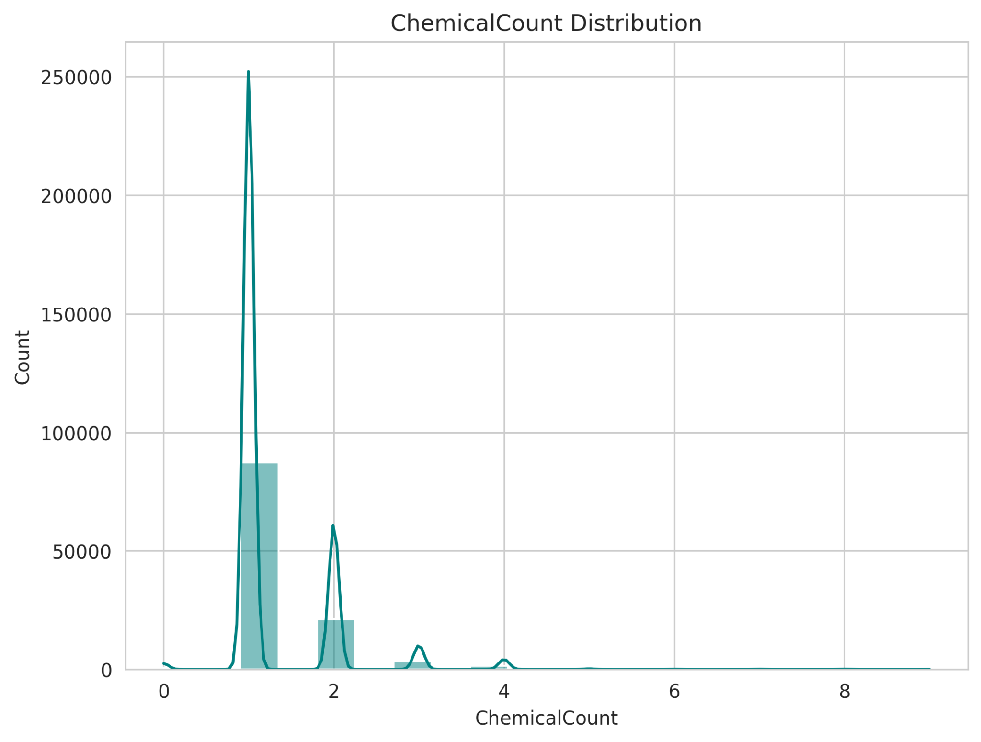
Chemical Count
Most products contain 0-2 chemicals.
There are occasional products with more than 4 chemicals, but they are rare.
Indicates that simpler formulations are more common.
Notes:
This histogram shows that most cosmetic products in our dataset contain only a few chemicals, typically between 0-2. A small number of products have higher chemical counts, but they are outliers. This suggests that brands tend to use minimal ingredients, possibly to comply with safety regulations or simplify formulations

Slide 7
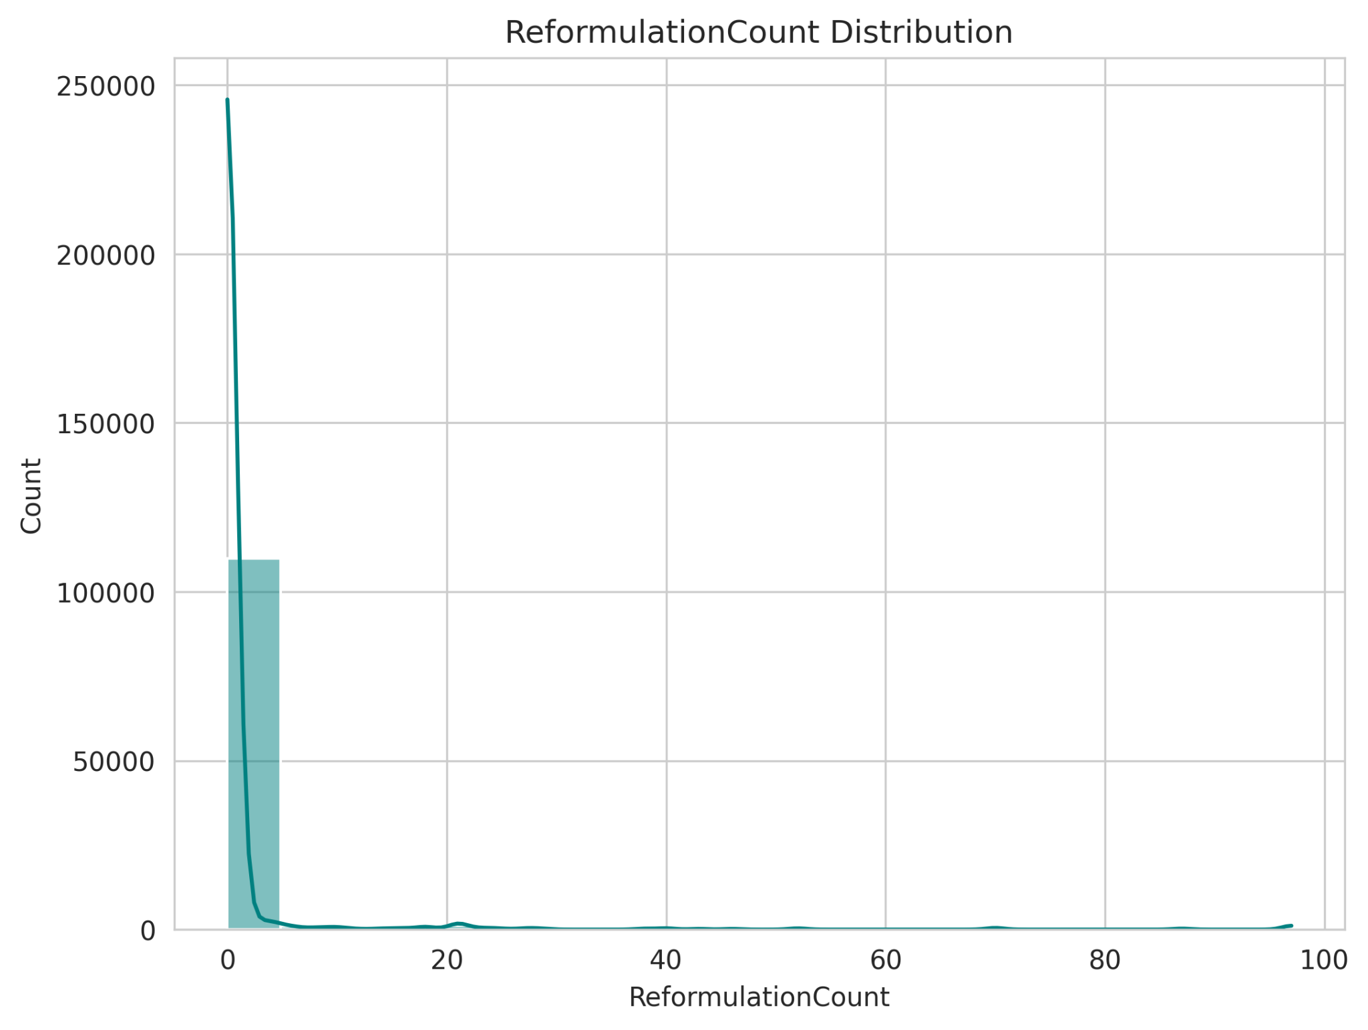
Reformulation Count
Most products are reformulated only a few times.
A small number of products have undergone 20+ reformulations.
Suggests that highly reformulated products might be reacting to market trends or ingredient bans.
Notes:
Here, we see that most products are reformulated only a handful of times, likely due to minor improvements or regulatory changes. However, a few products have been reformulated extensively, possibly indicating they had issues with consumer acceptance or ingredient restrictions

Slide 8
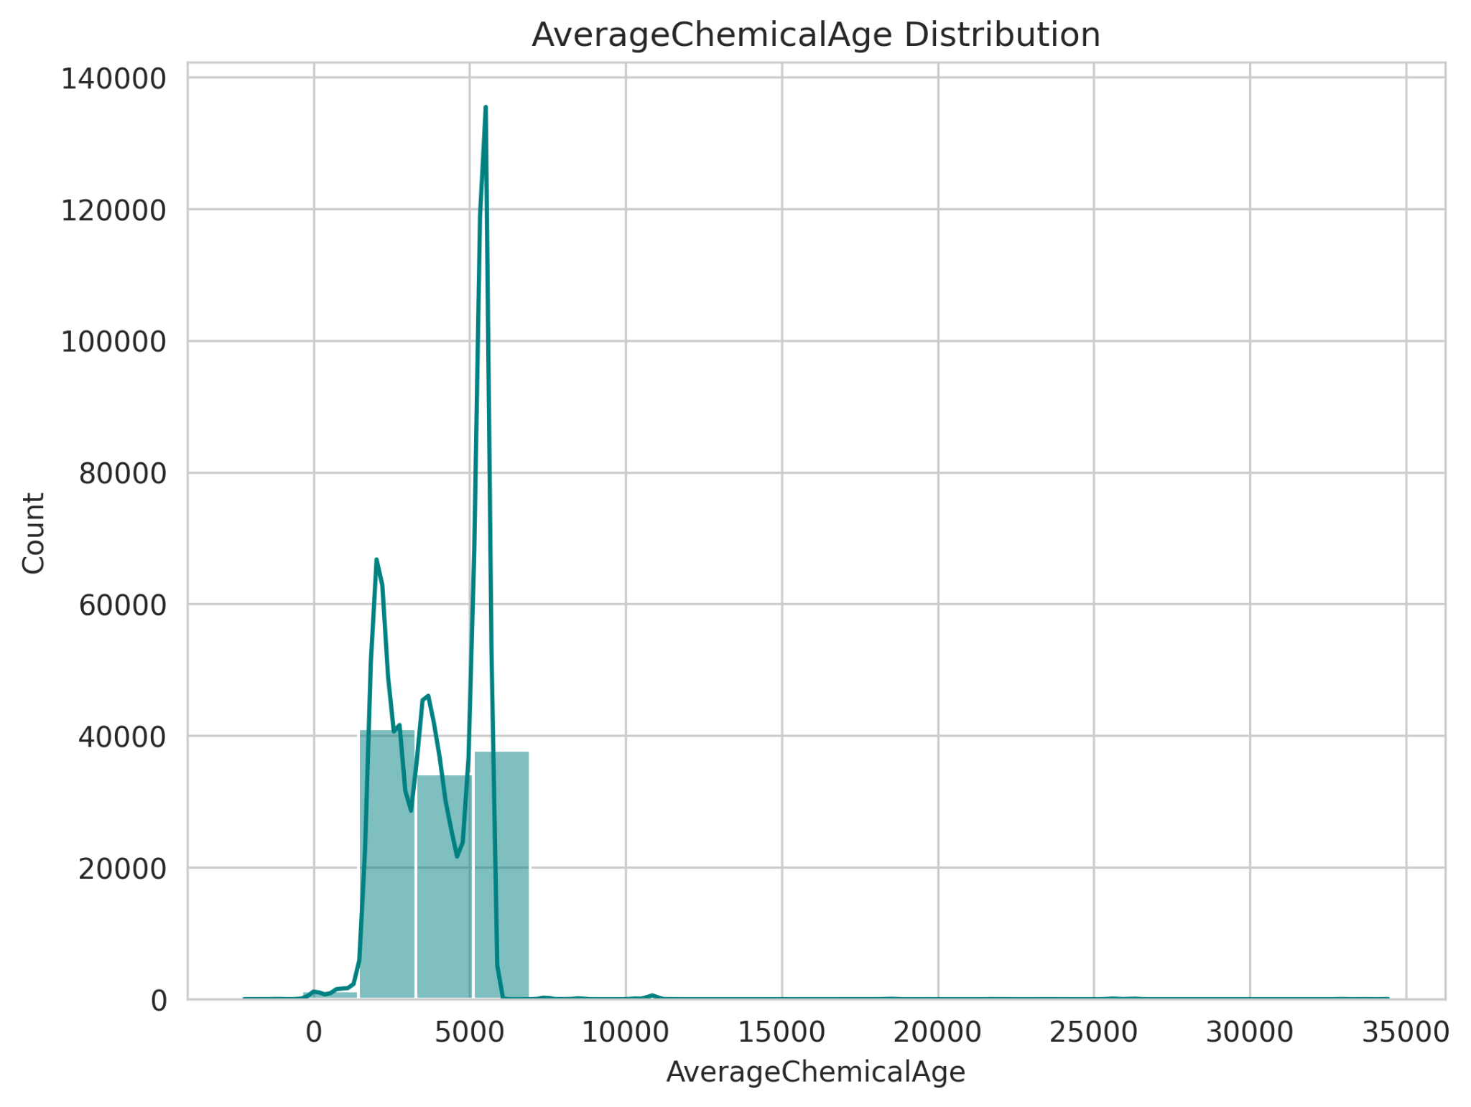
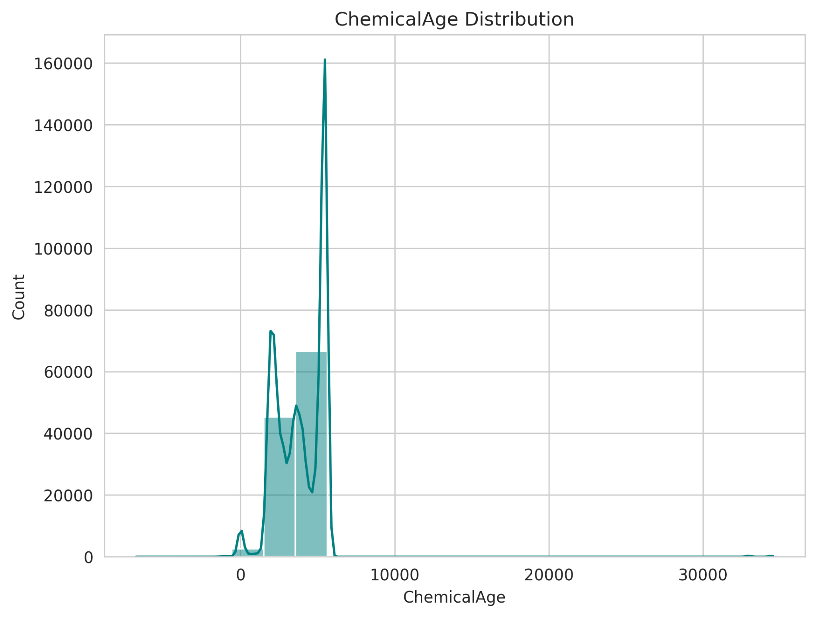
Chemical Age
Chemical Age shows a peak at lower values, meaning new chemicals are frequently introduced.
Some chemicals have been in use for 30,000+ days (~80 years), indicating legacy ingredients.
Suggests a mix of innovation and reliance on established ingredients.
Notes:
These graphs illustrate how long chemicals have been in use. Many chemicals are relatively new, which aligns with ongoing innovations in cosmetic chemistry. However, we also see long-standing ingredients that have been used for decades. This balance of innovation and tradition is crucial in formulation decisions."

Slide 9
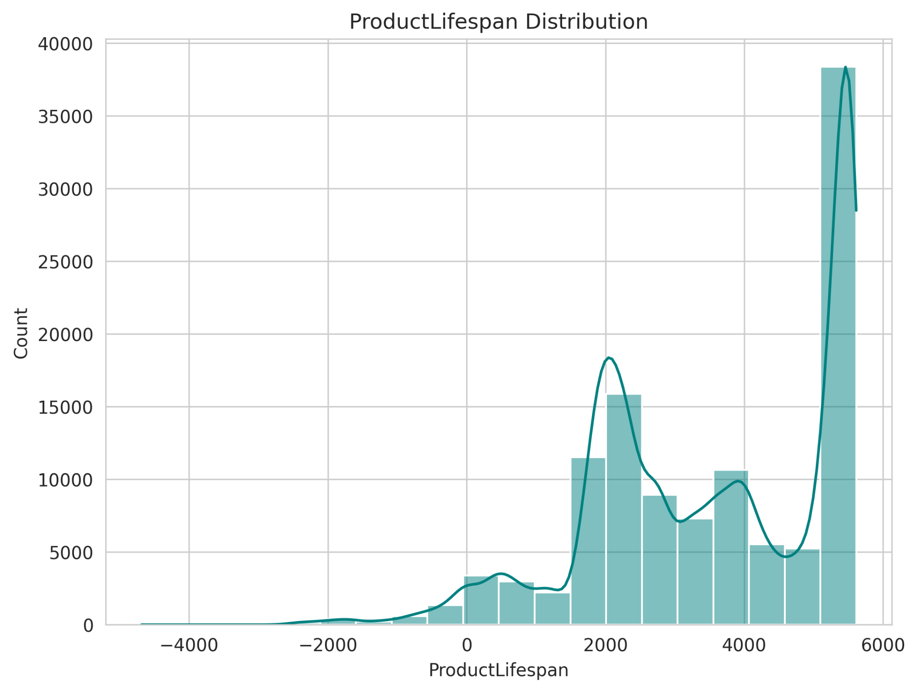
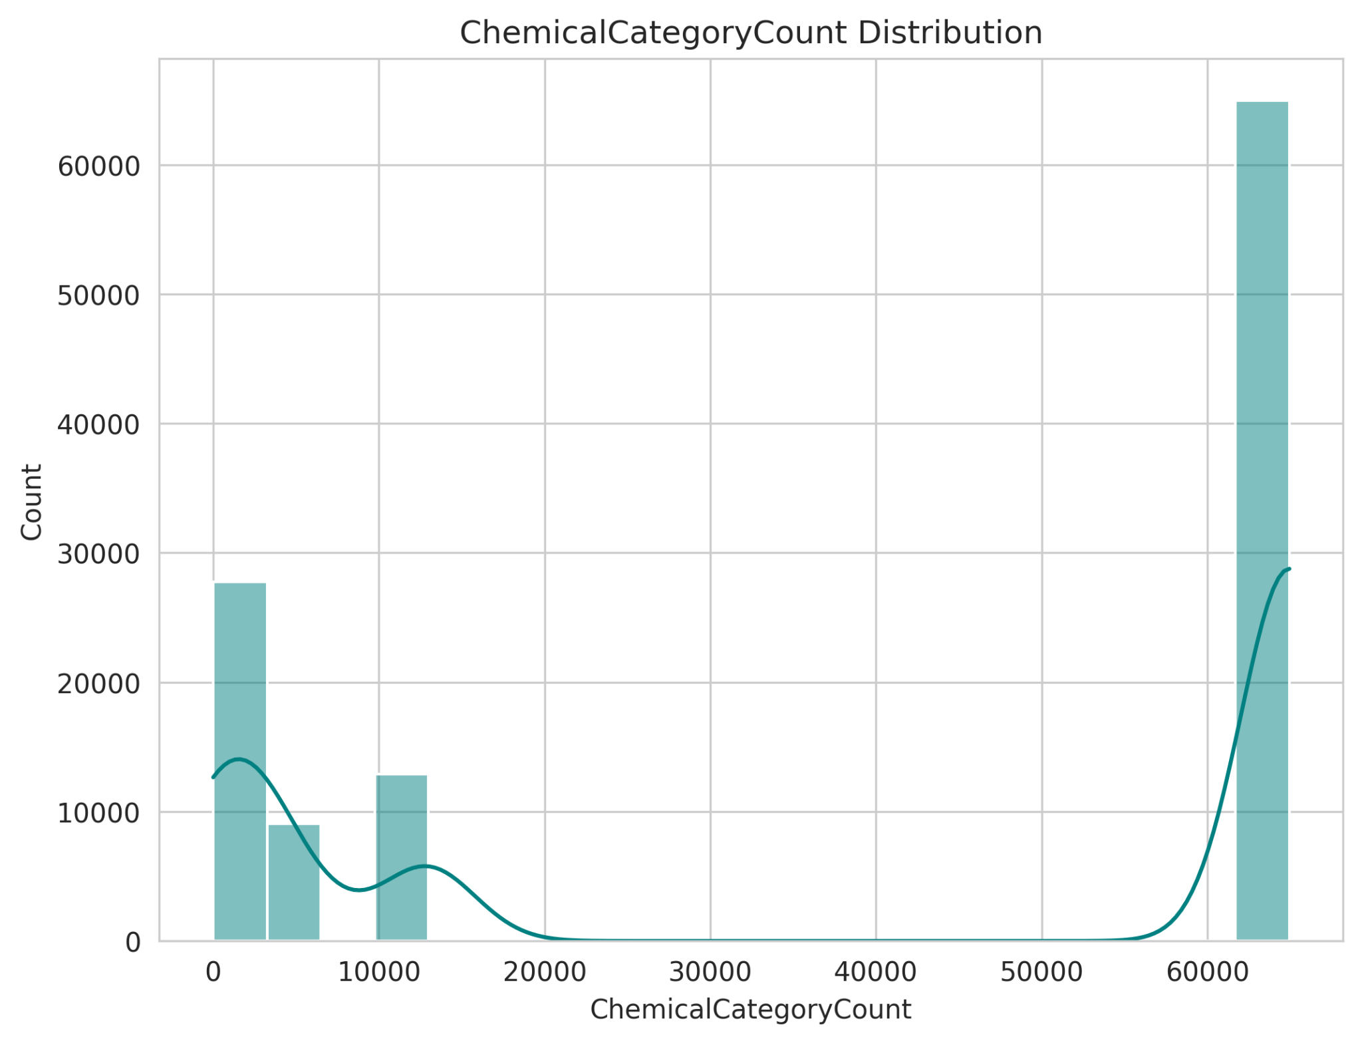
Product Lifespan & Chemical Category
Product lifespan varies widely, with some lasting for decades.
A large peak around 5000-6000 days (~15 years), suggesting common life cycle for products.
Some products contain chemicals from multiple categories, indicating complex formulations.
Notes:
The Product Lifespan distribution suggests that some cosmetic products stay on the market for decades, while others are short-lived. Meanwhile, the Chemical Category Count shows that some products contain a diverse mix of chemical types, likely impacting their efficacy, stability, and safety.

Slide 10
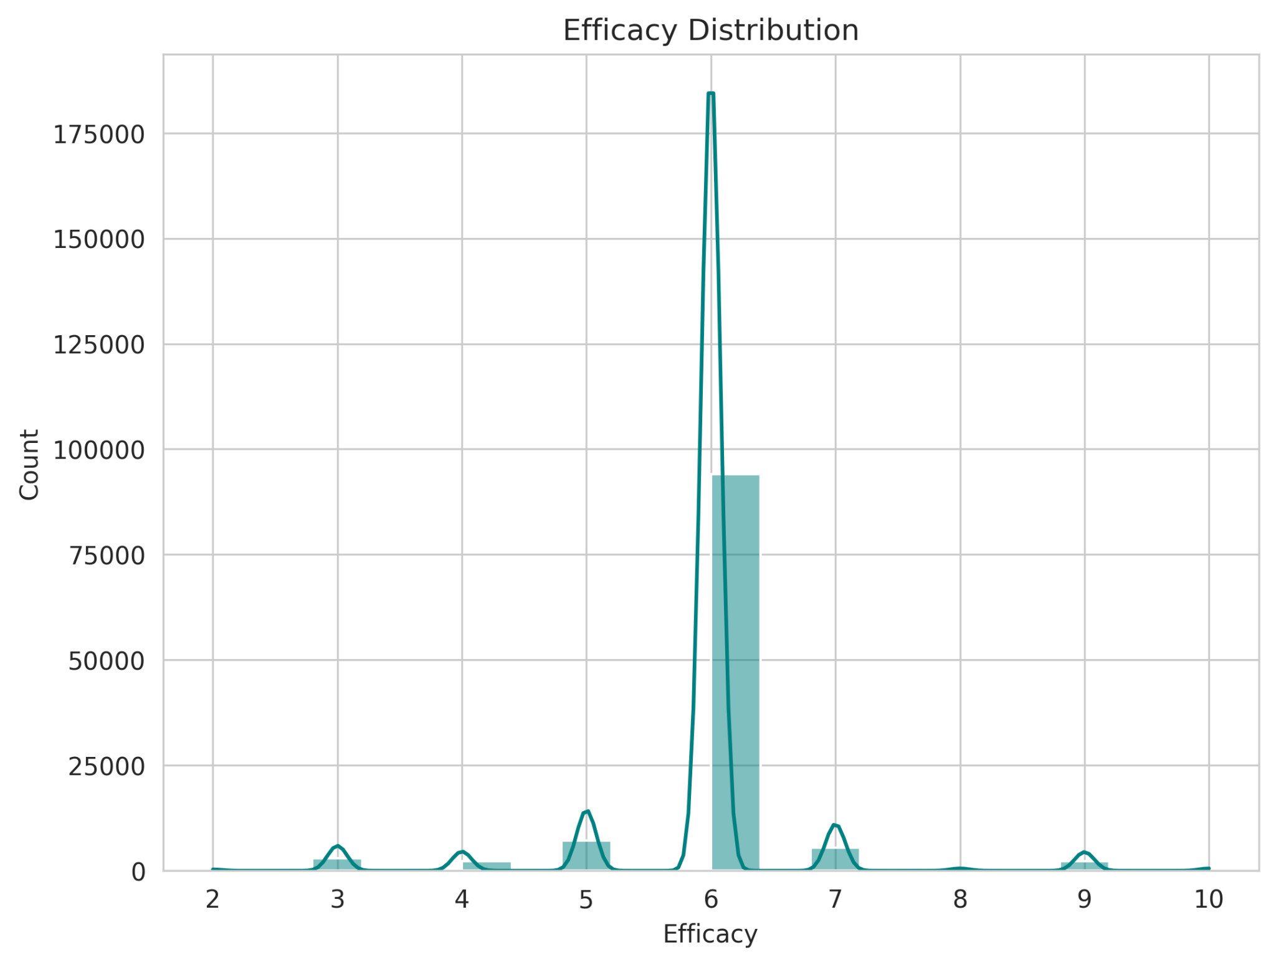
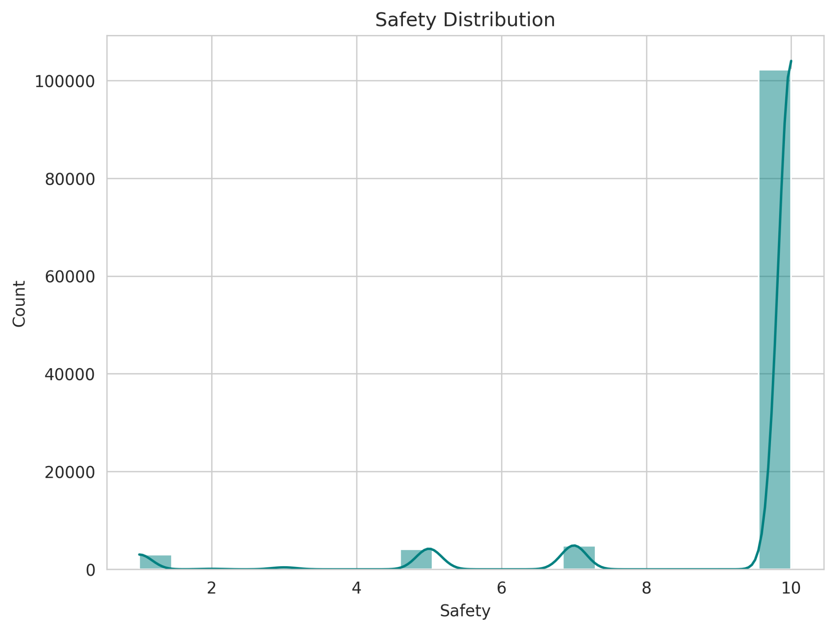
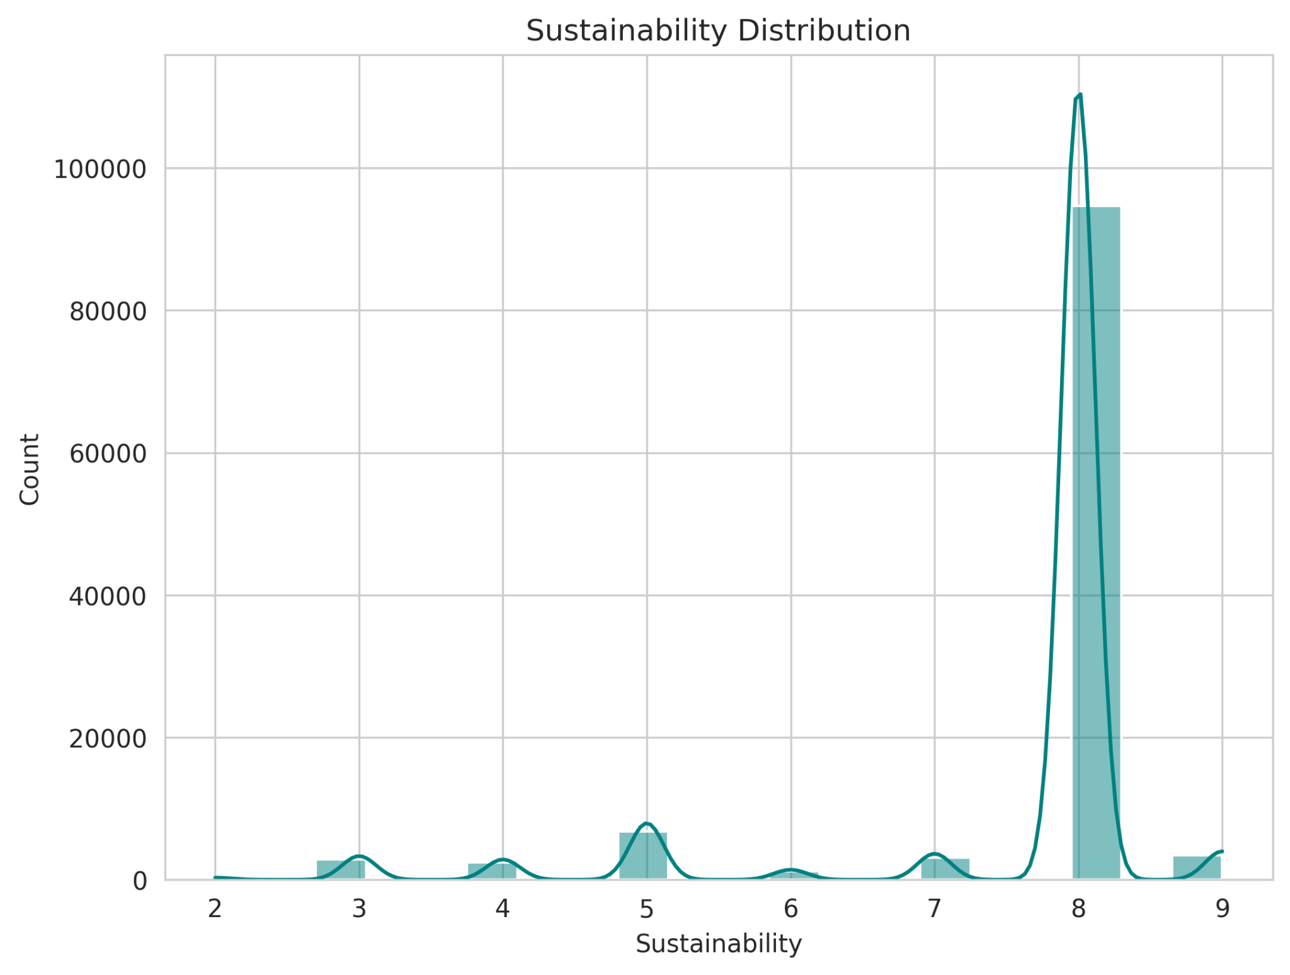
Efficacy, Safety, & Sustainability
Efficacy: Most products cluster around a score of ~6-7, meaning most products aim for a balance of performance.
Safety: High safety ratings (~9-10) dominate, suggesting regulatory compliance is prioritized.
Sustainability: Many products aim for high sustainability (~8-9), but there is some variation.
Notes:
These metrics show that most products are formulated for high safety and sustainability while maintaining efficacy. The high safety scores indicate strong regulatory adherence, while sustainability trends suggest that brands are responding to consumer demand for eco-friendly formulations

Slide 11

Future Plan
Reference the FDA
Integrate external toxicity databases to improve chemical risk classification.
Deeper Analysis
Explore correlations between reformulation trends and regulatory bans or consumer preferences
Machine Learning Model
Predicting whether a product will be reformulated based on its chemical composition. Classifying products based on hazard risks or sustainability scores.
Notes:
ChemicalDateRemoved (Binary Reformulation Indicator)
Objective: Predict whether a chemical will be removed from a product.
Transformation: Convert it into a binary target (1 = Removed, 0 = Not Removed).
Why? This aligns with your goal of identifying reformulation trends.
HazardType (Multiclass Classification)
Objective: Predict the hazard level of a chemical based on product and formulation data.
Why? Helps assess how regulatory actions affect ingredient safety classification.

Slide 12
Conclusion
Key Takeaways
Addressing categorical dominance and dataset imbalance significantly improved model performance.
Cosmetic reformulation trends are largely driven by regulatory requirements and consumer safety concerns.
Only a small percentage of flagged ingredients posed real risks, emphasizing the importance of better data labeling.
Notes:
The results revealed that cosmetic reformulation trends are primarily influenced by regulatory requirements and consumer safety concerns rather than purely market-driven changes. This insight is crucial for understanding how brands adapt over time.
Interestingly, while many ingredients were flagged as potentially hazardous, only a small percentage posed actual risks based on established safety assessments. This highlights the need for more accurate and standardized data labeling to avoid unnecessary reformulations and misinformation.

